Slide 1
Analyzing influencers and geographical sentiment distribution for tweets on the Zika Virus in the United States
GVS Akshay (Team Leader)
Saurabh Rao
Kaushik Kandlakunta

Slide 2
Motivation
To understand :
Conversation about the Zika Virus in regions with the highest population in the United States.
Sentiment distribution in each region
Major keywords regarding the Zika virus
Major influencers

Slide 3
Hypothesis
Most conversations about Zika in the United States are influenced by individuals.
Regions close to the coast which are more likely to receive people harboring the Zika virus are more concerned about virus.
The overall sentiment is neutral, owing to the informational nature of the tweets.

Slide 4
Data collection
Gather API credentials from Twitter developers (access tokens)
Download twitteR package for R
Authenticate application and create cred environment
Define required variables
Define latitude, longitude and radius variables
Define sentiment function
Make REST API call
Avoid rate limiting

Slide 5
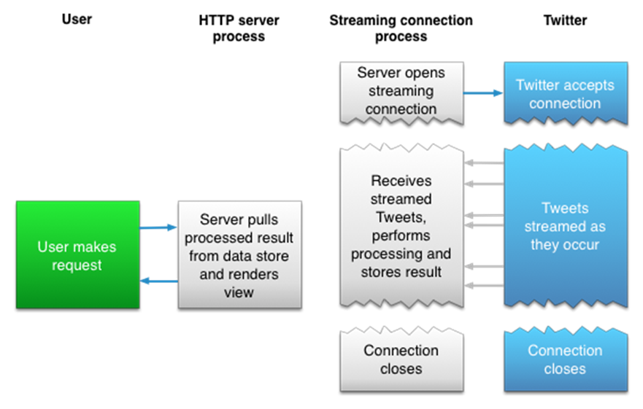

Slide 6
Data Description
Created – time and date variable
favoriteCount – integer
Favorited id – long integer
isRetweet – Boolean (T/F)
Latitude -long integer
Longitude – long integer
replyToSID – string
replyToSN – string
replyToUID – string
retweetCount – integer
Retweeted – Boolean (T/F)
screenname – string
statusSource – string
Text – string
truncated - Boolean(T/F)

Slide 7
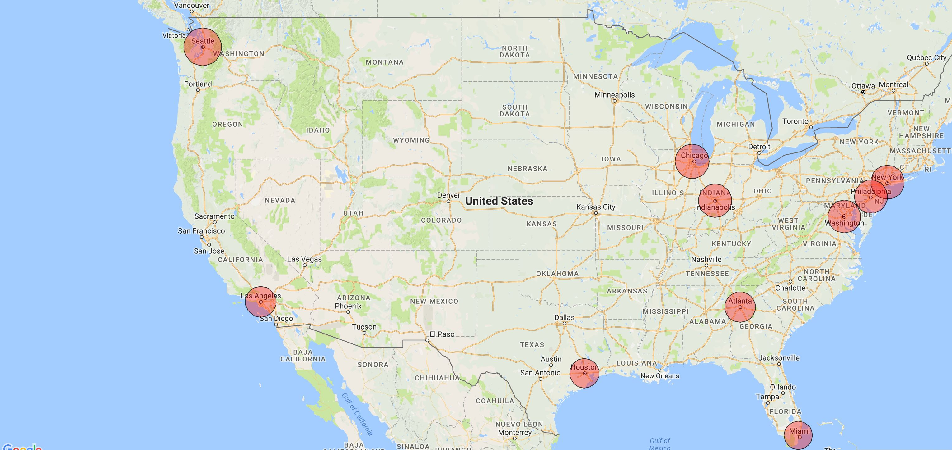
Geographic distribution of the tweet collection
OUR OFFICE

Slide 8
Data cleaning
Convert text from UTF-8 to ASCII
Remove punctuation marks
Remove “@”
Convert to lowercase

Slide 9
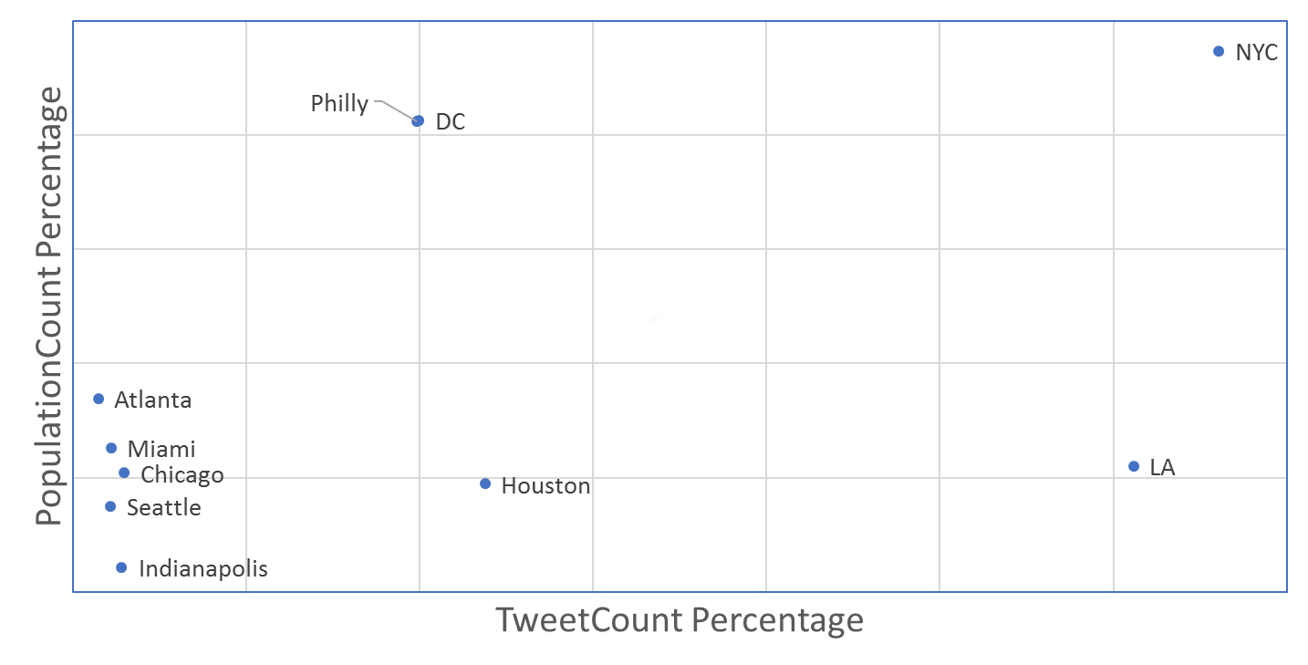
Exploratory data analysis
Total population : 61,125,196 (18.92% of total US population) Total tweets : 3095

Slide 10
Sentiment analysis
Collect a corpus of negative and positive keywords ( ~ 7000 words )
Convert each tweet as a string and save entire dataset as a dataframe
For each tweet , calculate score as follows : If positive keyword encountered , score_pos= + 1 If negative keyword encountered , score_neg= -1
Total score = score_pos + score_neg
Assign label as positive, negative or neutral based on score
Repeat process for each geographical region under consideration

Slide 11
Getting node edge list

Slide 12
Part 1 – Reasoning and types
A tweet can be retweeted from someone, can be a reply to another tweet.
This has a cascading effect (a retweeted tweet can be retweeted again)
Instead of a cascading structure, we used a time constraint based approach.
This is to understand the “virality” of the tweet (retweet count in a predefined time delta)
For retweet , extract username of person retweeted from and person retweeting ( source and target node )
For reply , extract original tweet and reply tweet ( source and target node )

Slide 13
Part 2 – Assigning weights
Considered retweet count , favorite count , Reply or not for weight.
Normalize retweet count, favorite count by dividing every entry by maximum value in each column ( ie, maximum possible value is 1 ).
Reply or not is a Boolean value , convert to 1 for TRUE , 0 for FALSE.
Assign weights by using the formula weight= X1*(Normalized_rt_count) + X2*(Normalized_fav_count) + X3*(Reply_or_not) ∋ for tweet_count=(1:n)
{ Σ(Normalized_rt_count[tweet_count] + Normalized_fav_count[tweet_count] + Reply_or_not[tweet_count]) = Σ weight }
Where X1,X2,X3 are constant values ∋ 0 ≤ X1,X2,X3 ≤ 1 . X1,X2,X3 are heuristically tweaked to ensure the optimal degree of normality. Condition for normality : mean(Σweight) ≈ median(Σweight) ≈ mode.mult(Σweight)

Slide 14
Variable | Retweets | replies | retweet+replies
connected components | 1.311 | 1.229 | 1.332
avgweighteeddeg | 0.099 | 1.269 | 0.274
network diameter | 3 | 1 | 4
avg path length | 1.34146341 | 1 | 1.4297082
density | 0.001 | 0.004 | 0.001
modularity | 0.629 | 0.821 | 0.871
modularity with resolution | 0.629 | 0.821 | 0.871
num of communities | 375 | 76 | 427
pagerank
epsilon | 0.001 | 0.001 | 0.001
probability | 0.85 | 0.85 | 0.85
connected components
no of weakly connected components | 359 | 71 | 397
no of strongly connected components | 984 | 166 | 1118
average clusterting coefficient | 0.003 | 0.004 | 0.004
eigenvector centrality
no of iterations | 100 | 100 | 100
sum change | 0.0638098 | 0.01096035 | 0.084305431

Slide 15

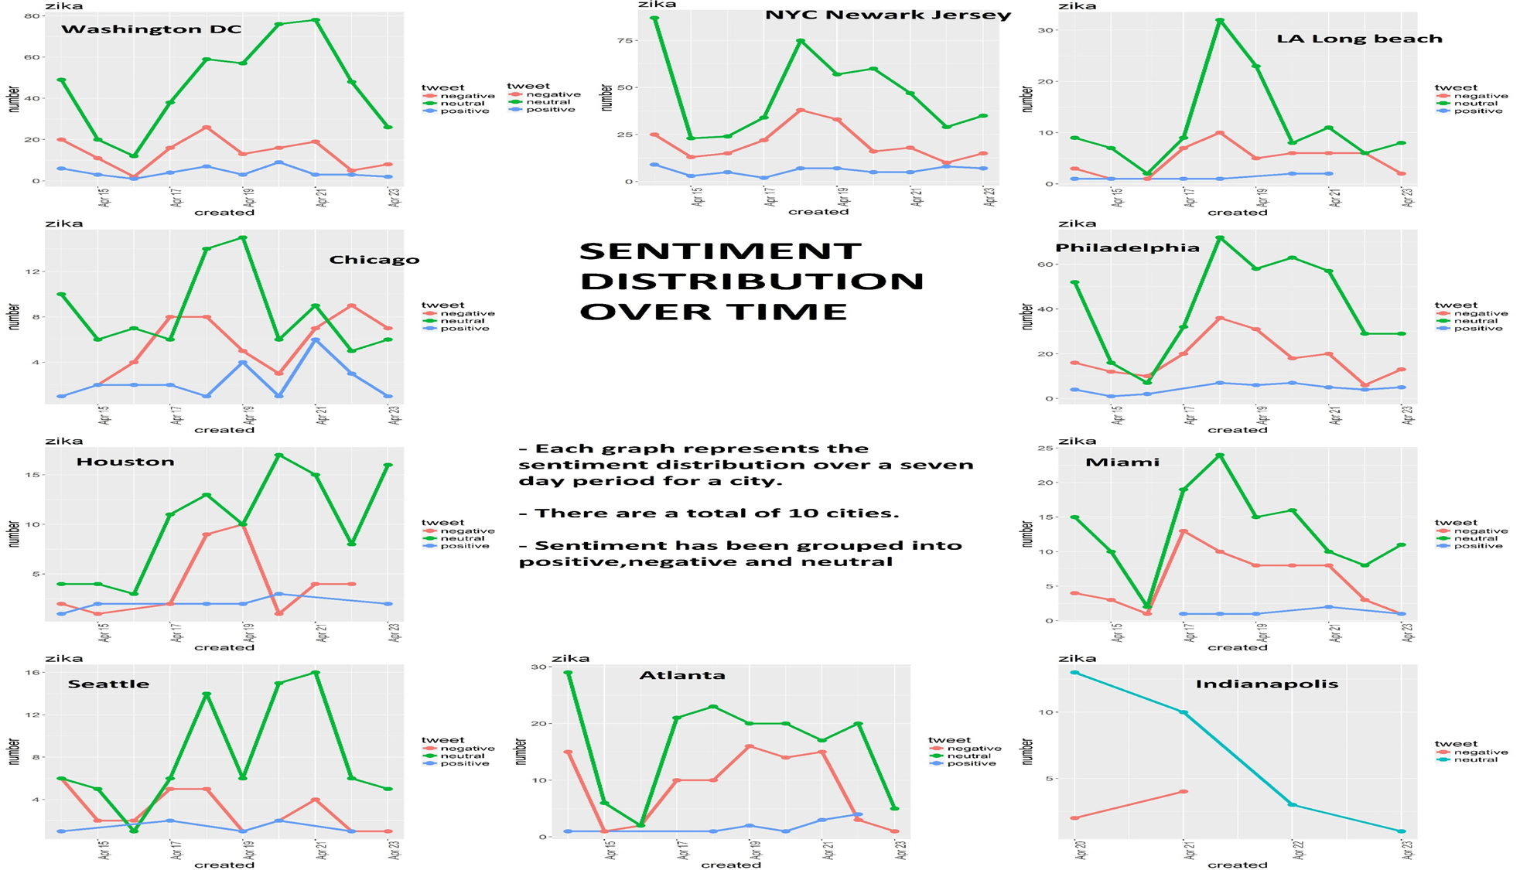
Want big impact?
USE BIG IMAGE

Slide 16
Conclusions
Most conversations about Zika in the United States are influenced by corporations and issue specific accounts rather than individuals.
Regions close to the East coast are more concerned about the Zika virus than those in the Midwest , center or West coast.
The overall sentiment is neutral, owing to the informational nature of the tweets.

